Slide 1
Integrating machine learning and decision analysis W. Alton Russell, PhD Assistant Professor McGill School of Population and Global Health
EPIB 676-2, McGill University, 22 March 2023

Slide 2
Agenda
Improving decision analyses with ML
Targeting overdose prevention for prescription opioid patients
Improving ML risk prediction through a decision science lens

Slide 3

Why does heterogeneity matter?
Traditional decision-analytic models focus on average outcomes
Increased interest in distributional outcomes across heterogeneous populations
Enable targeted intervention
Inform equity-related impact
Can also improve estimation of aggregate outcomes!
Source: pmlive.com

Slide 4
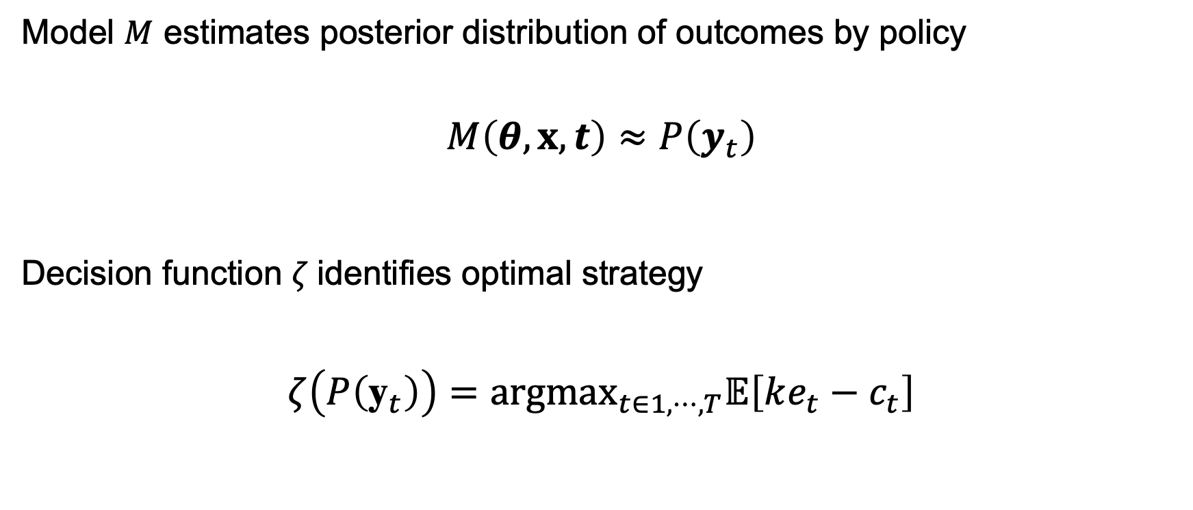
Traditional decision analysis setting
Model $M$ estimates posterior distribution of outcomes by policy
$$M\left(θ,x,t\right)≈P\left(y_{t}\right)$$
Decision function $ζ$identifies optimal strategy
$$ζ\left(P\left({\text{y}}_{t}\right)\right)={argmax}_{t∈1,⋯,T}𝔼\left[ke_{t}−c_{t}\right]$$
Parameters
Policies
Data (sometimes)
Outcomes by policy (multivariate)
Effectiveness
Cost
Maximize population net monetary benefit
Willingness to pay

Slide 5
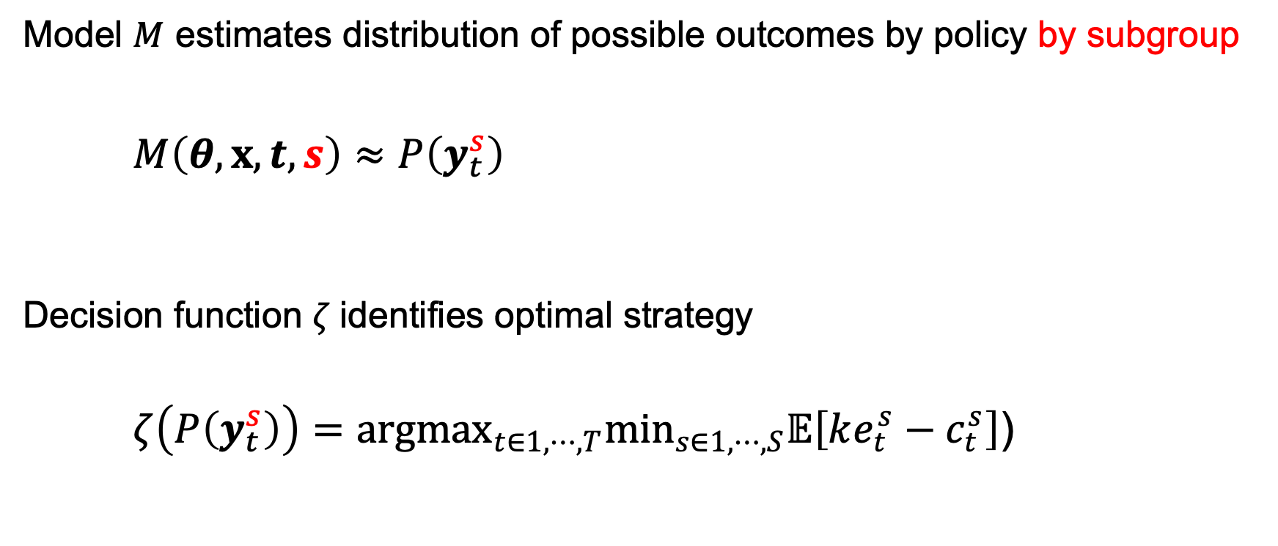
Decision analysis with subgroups
Model $M$ estimates distribution of possible outcomes by policy by subgroup
$$M\left(θ,x,t, s\right)≈P\left(y_{t}^{s}\right)$$
Decision function $ζ$identifies optimal strategy
$$ζ\left(P\left(y_{t}^{s}\right)\right)={argmax}_{t∈1,⋯,T}\min_{s∈1,⋯,S}𝔼\left[ke_{t}^{s}−c_{t}^{s}\right]\text{)}$$
Parameters
Policies
Still hard ☹️
State space explosion
Parameter estimation challenges
Data (sometimes)
Sub-groups
Outcomes by policy by subgroup
Substantial progress 🙂
Maximize net monetary benefit in worse-off subgroup

Slide 6
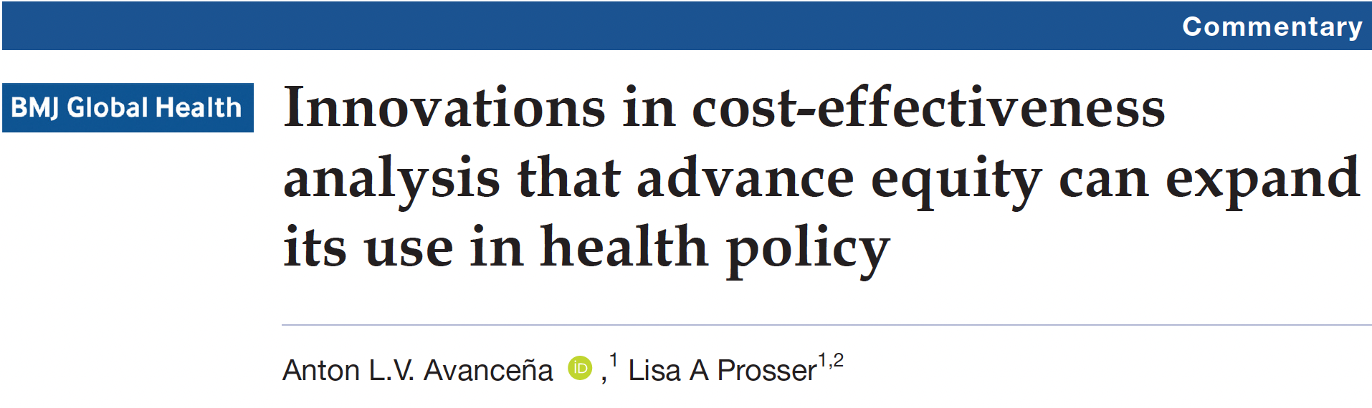
Equity-informative decision analytic frameworks
Distributional cost-effectiveness
Extended cost-effectiveness
Multi-criterion decision analysis
Ex poste equity weighting
Alternatives to quality-adjusted life year
Equal value of life years gained
Health years in total
⚠️ Presuppose subgroup heterogeneity in outcomes accurately estimated ⚠️

Slide 7
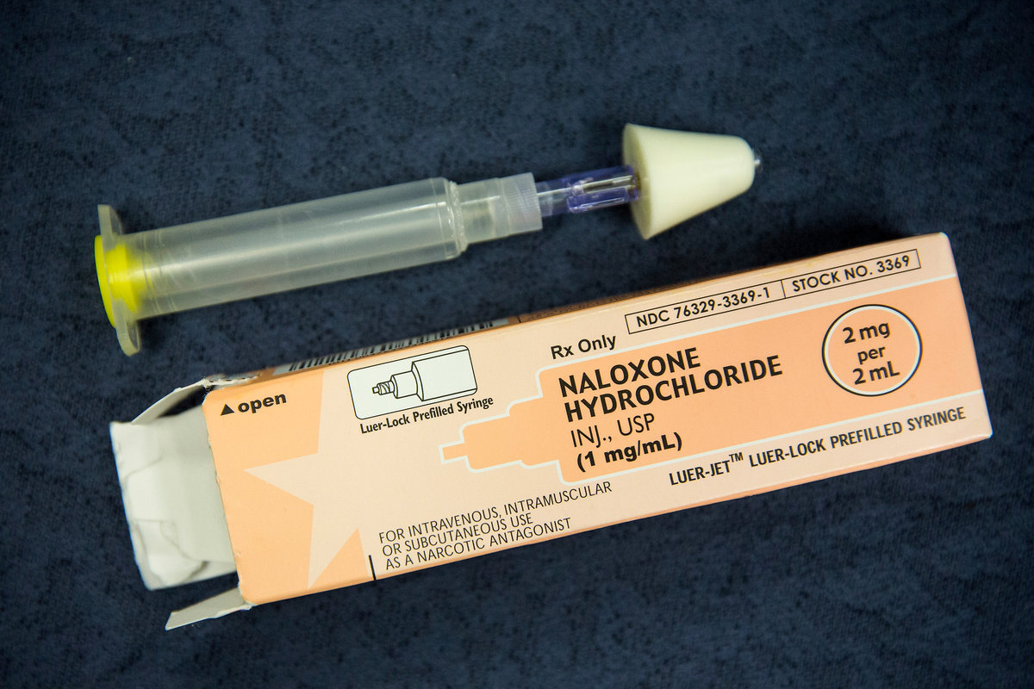
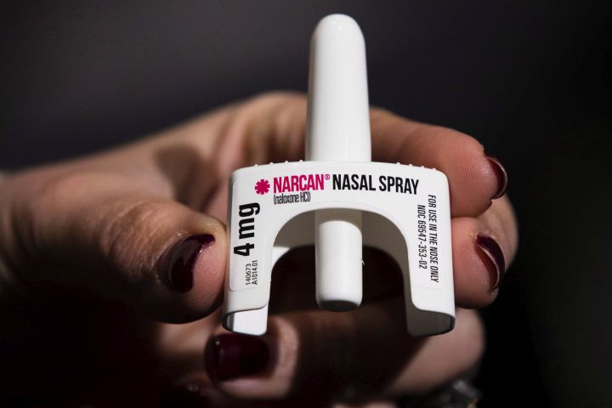
Naloxone reverses overdose (OD)
Take-home naloxone (THN) reverses witnessed and recognized opioid overdoses
Cost-saving for people using illicit opioids
Co-prescribing with prescription opioids recommended by CDC and in several US states for those at “high OD risk”
Who is high risk? Inconsistent definitions
ANDREW BURTON/GETTY IMAGES
THE CANADIAN PRESS/AP-Matt Rourke
OD: overdose, THN: take-home naloxone

Slide 8
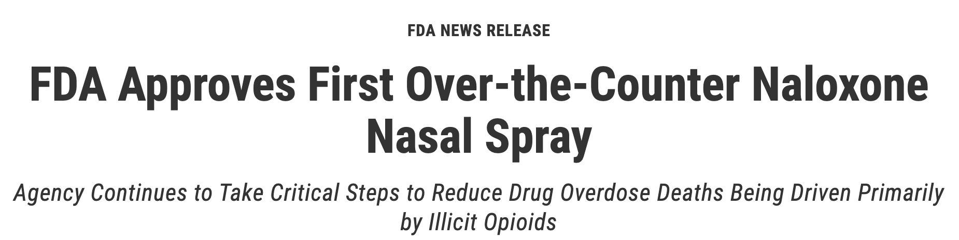
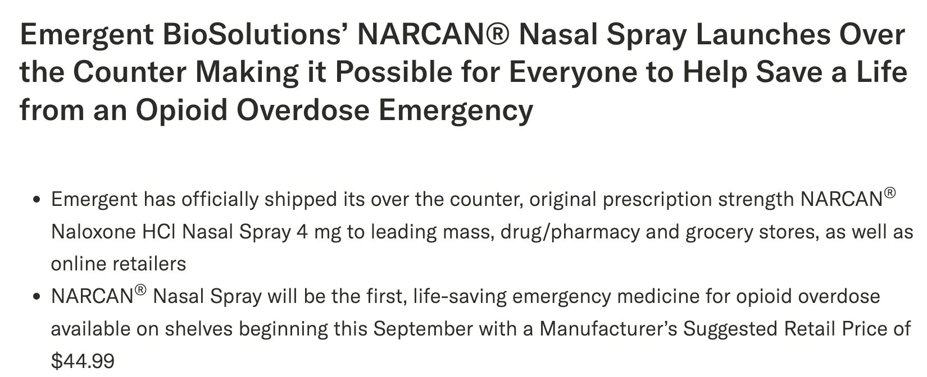
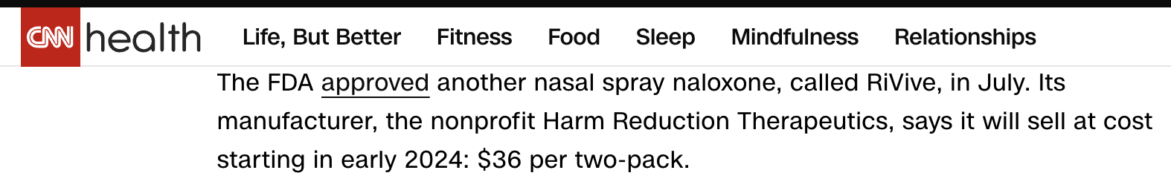
Mar 29, 2023
Aug 30, 2023
Sep 6, 2023

Slide 9

Objective
Use simulation to estimate:
Impact of THN on 2-year OD rate for patients prescribed opioids by OD risk indicator
Cost-effectiveness of THN by price
Past
$125
Present
$45
Future
$36
OD: overdose, OTC: over the counter, THN: take-home naloxone

Slide 10
Longitudinal patient-level data (IQVIA)
Drugs: all dispensed drugs for random sample of patients dispensed opioid analgesics Oct. 2018 – Sept. 2021
Construct opioid episodes, identify “risk indicator” drugs
Diagnoses: all diagnoses for linked patients
Identify diagnosed overdoses, identify “risk indicator” conditions
Demographics: age, sex, race
Strength: large, multi-payer dataset
Limitation: no data on death, including fatal overdoses

Slide 11
Method overview
Construct opioid episodes
Select cohort
Classify risk indicators
Predict diagnosed overdoses
Impute undiagnosed overdoses
OD rates by risk indicator?
Simulate outcomes with naloxone
Cost-effectiveness by price?
Cohort analysis
Policy simulation
OD: overdose

Slide 12
Construct opioid episodes
Series of opioid prescriptions with no gaps of >30 days in supply
“Carryover” accounts for overlapping days supplied
W days
Medication carryover
t
W days
Episode duration
For patients with complete data, used 1st episode Oct 2018 – Sep. 2019
3.99 million episodes; 3.98 without dispensed pharmacy naloxone

Slide 13
Definitions
2 years before episode start
Episode start
2 years after episode start
Diagnosis or drug indicating risk
Episode end
Naloxone dispensed (excluded from simulation)
Outcome: Opioid Overdose

Slide 14
Identify risk indicators
Drug-related (17)
Long term (not used in policy simulation)
High dose
Antipsychotic
Stimulant
Anti-depressant
Anxiolytic
MOUD (medication for opioid use disorder)
Mood stabilizer
Clonidine
Antiseizure
Benzodiazepine
Barbiturates
Pregabalin
Muscle relaxant
Gabapentin
Z-drug
Prazosin
Diagnosis-related (6)
Mental health
Nicotine dependence
Substance use
Severe mental health
Dementia
OD (overdose), poison, self-harm

Slide 15
Percent of patients with each risk indicator Overall and with overdose

Slide 16
Percent of patients with each risk indicator Overall and with overdose

Slide 17
Percent of patients with each risk indicator Overall and with overdose

Slide 18
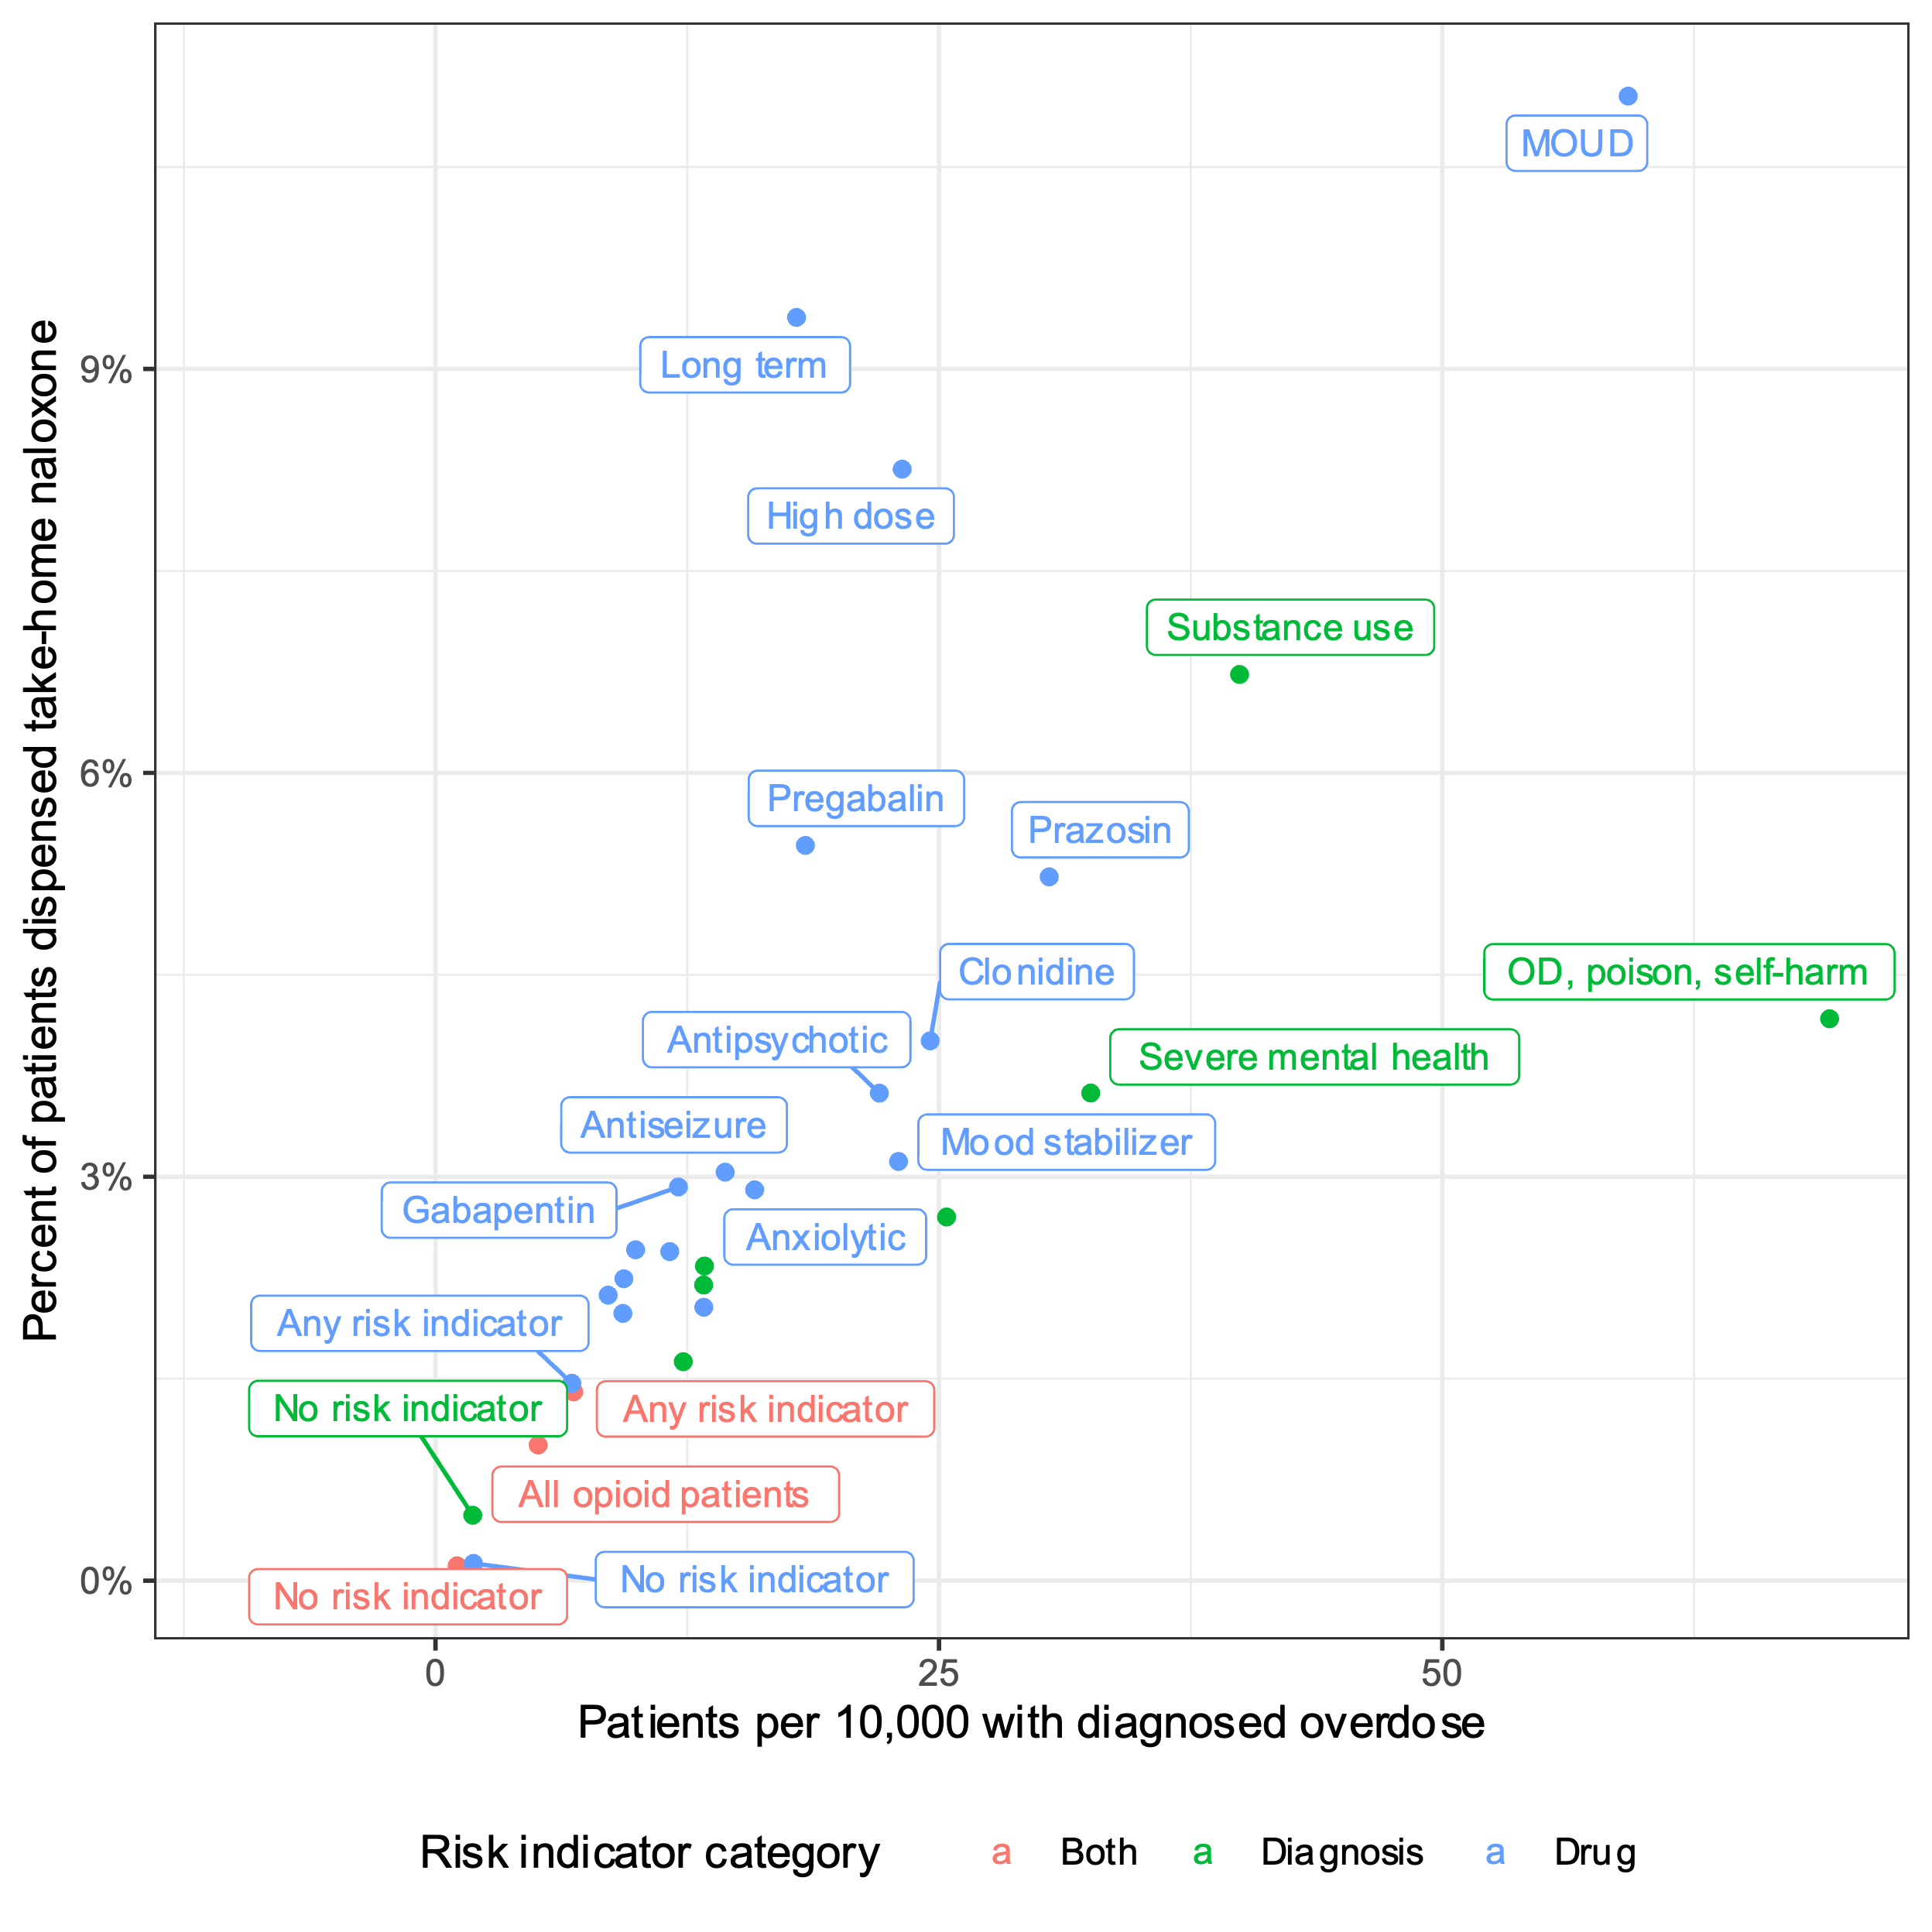
Take home naloxone vs. overdose rate
MOUD = medication for opioid use disorder
OD = overdose
Overall, 1% episodes had co-dispensed pharmacy THN

Slide 19
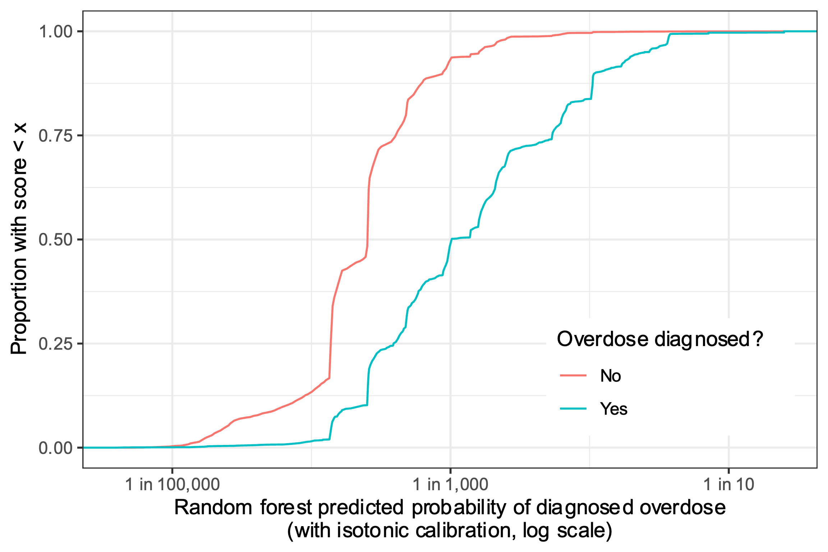
Diagnosed overdose prediction model
Used to assign risk of fatal ODs
(Assumption: risk factors for unobserved fatal OD and diagnosed OD similar)
Random forest model
Predictors: risk indicators, episode duration, age, sex, race, etc.
Out-of-sample AUC 82%
Good discrimination & probability calibration
OD: overdose

Slide 20
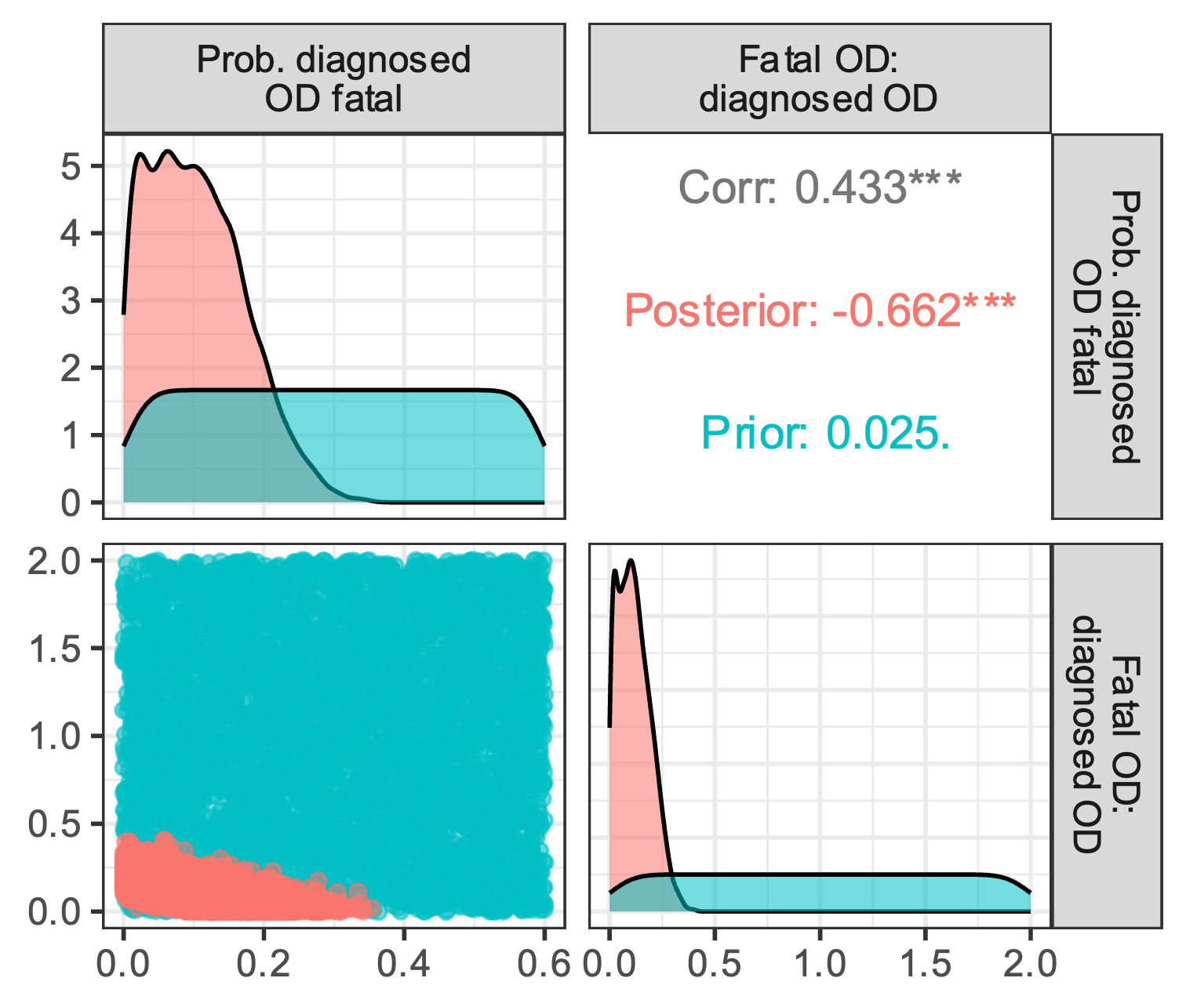
Imputing fatal ODs
Bayesian model calibration
Incremental mixture importance sampling
Used 2 calibration targets…
2-year rate of fatal OD
Ratio of fatal : non-fatal diagnosed overdose
…to generate sets of 2 parameters
Proportion of diagnosed ODs that ‘turn’ fatal
Ratio of fatal OD to diagnosed OD
OD: overdose

Slide 21
Policy simulation assumptions
THN can avert fatal overdoses within 2 years
THN used when
Overdose witnessed 40% to 80% probability
THN available 30% to 50% probability
Bystander uses it 62% to 92% probability
If used
Prevents fatal overdose 80% to 99.9% probability
THN: take-home naloxone

Slide 22
Health economic outcomes
Societal perspective (considers productivity impact)
Non-fatal overdose
Healthcare costs
Loss of quality-adjusted life year (1-5 days per OD)
Loss of productivity (0.2 to 20 days)
Fatal overdose
Loss of remaining expected QALYs (age-based)
Loss of remaining lifetime net productivity
OD: overdose, QALY: quality-adjusted life year

Slide 23
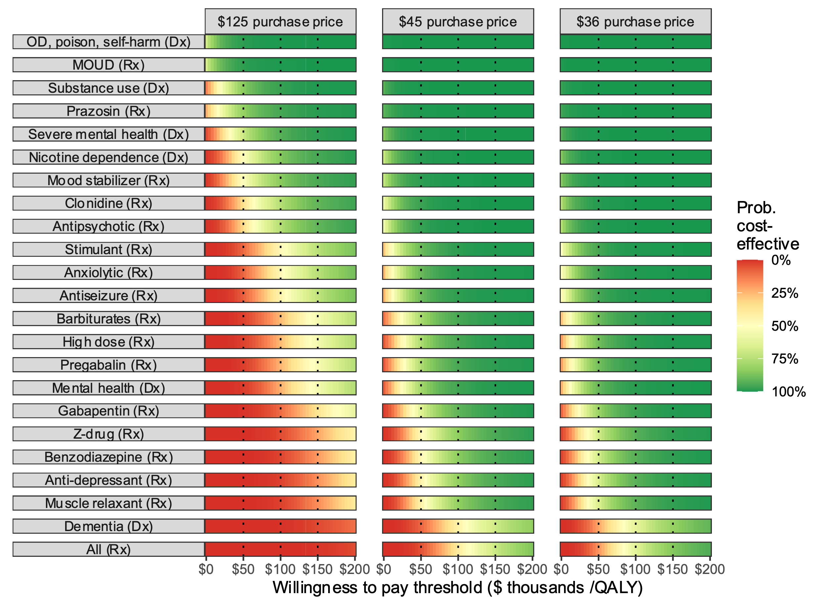
Cost-effectiveness by risk indicator
Price drop with OTC
Possible further price drop
At $100,000 per QALY:
THN now CE for most patients with OD risk indicator
Future price drop increase probability “THN for all Rx opioid patients” is CE from 40% to 62%
CE: Cost-effective, Dx: diagnosis, MOUD: medication for opioid use disorder, OD; overdose, Rx: drug, QALY: quality-adjusted life year
0.2%
40%
62%

Slide 24
As price drops, THN cost-effective for more risk indicators
Purchase price | Group for whom it’s cost-effective with probability > 50% at this price | N (%) patients
$200 | Nicotine dependence (Dx); Substance use (Dx); Severe mental health (Dx); OD, poison, self-harm (Dx); Mood stabilizer (Rx); MOUD (Rx); Prazosin (Rx) | 573 017 (14.5%)
$175 | Clonidine (Rx) | 635 217 (16.1%)
$172 | Antipsychotic (Rx) | 758 660 (19.2%)
$126 | Anxiolytic (Rx) | 947 371 (24.0%)
$125 | Stimulant (Rx) | 1 027 453 (26.0%)
$123 | Antiseizure (Rx) | 1 115 868 (28.2%)
$102 | Barbiturates (Rx) | 1 161 269 (29.4%)
$101 | High dose (Rx) | 1 233 761 (31.2%)
$100 | Mental health (Dx) Pregabalin (Rx) | 1 620 975 (41.0%)
$84 | Gabapentin (Rx) | 1 896 917 (48.0%)
$71 | Z-drug (Rx) | 1 976 756 (50.0%)
$70 | Benzodiazepine (Rx) | 2 243 645 (56.8%)
$69 | Anti-depressant (Rx) | 2 468 223 (62.5%)
$68 | Muscle relaxant (Rx) | 2 718 850 (68.8%)
$43 | Dementia (Dx) | 2 722 785 (68.9%)
$42 | All (Rx) | 3 950 701 (100.0%)
Dx: diagnosis, Rx: drug, MOUD: Medication for Opioid Use Disorder, THN: take-home naloxone

Slide 25
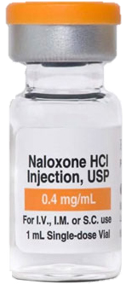
Take-aways
New over-the-counter price makes THN cost-effective for most prescription patients with OD risk indicator
At $45 we estimate:
Targeted THN cost-effective for nearly all risk indicators at $100,000/QALY
Untargeted THN may not be cost-effective
Limitations:
Does not consider access + affordability
Impact on insurance coverage? Availability through social programs?
Uncertainty could be reduced by
Better naloxone utilization data for patients prescribed opioids
Linked fatal OD data
Method take-away: combining cohort analysis, machine learning, & simulation can enable granular policy evaluation
OD: overdose, THN: take-home naloxone

Slide 26
Agenda
Improving decision analyses with ML
Targeting overdose prevention for prescription opioid patients
Improving ML risk prediction through a decision science lens

Slide 27
Case study: Targeted follow-up to prevent chronic kidney disease after inpatient acute kidney injury
Background
At Lucile Packard Children’s Hospital, about 25% of ICU patients and 5% of floor patients experience acute kidney injury (AKI) during hospitalization
Some AKI survivors go on to develop chronic kidney disease (CKD)
Insufficient capacity to follow up with all AKI survivors
Objective
Predict risk of chronic kidney disease (CKD) 3-12 months after a hospitalization
Enroll highest-risk patients in new AKI survivors’ clinic for follow-up renal care
Notes:
We can’t follow up with ALL AKI survivors, but if we knew who were at greatest risk then we could follow up with SOME

Slide 28
Case study prediction task
(1) Predict:
(2) Enroll: The highest-risk patients will be enrolled in a new AKI survivors’ clinic
Inpatient stay
3 – 12 months after discharge
AKI develops
CKD stage 3+ may or may not develop
At discharge, which AKI survivors will develop CKD in the next 3-12 months?
AKI = acute kidney injury; CKD = chronic kidney disease

Slide 29
Developing clinical risk prediction with supervised learning
Features
Train & validate: Learn a function mapping features to outcomes
Predicted Outcome
Labeled Outcome
Minimize difference
Features
Test: Make sure the model performs well on unseen data
Predicted Outcome
Labeled Outcome
Verify they’re close
Features
Implement: Use the model on unlabeled data to inform clinical decisions
Predicted Outcome
Inform Decision
Notes:
The basic procedure for developing an ML prediction algorithm is well known and widely accepted.
There are numerous excellent free online courses and bootcamps
Looking at disparity between # of published prediction models and # of models that have been implemented in clinical settings, it’s clear that mastering this process is not sufficient for successful implementation

Slide 30


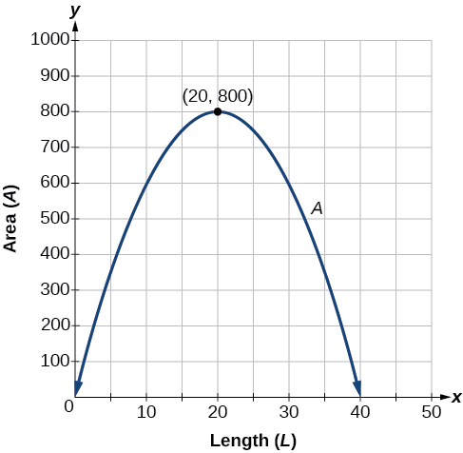
Zooming out
Features
Prediction
How do we evaluate the potential value of the prediction model?
Decision
Clinical workflow
Outcome
Decision
How does the prediction model fit into the clinical workflow?
Features
Prediction
How do we design for maximal utility (rather than just predictive ability)?
Notes:
Zooming out, 3 questions that the train/validate/test procedure does not address

Slide 31

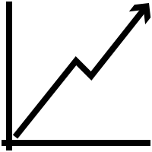
Keys to successful implementation
Assess potential value
Design for the workflow
Maximize utility, not accuracy

Slide 32
A model can add value when
Actionable intervention – intervening can change the outcome
Intervention creates value – intervening will improve health and/or save money
Expected value exceeds costs
Outcome would have happened
+ -
+
-
TP
FP
Predicted outcome would happen
Can calculate how good the model must be to add value
FN
TN
Notes:
If the patient really would experience an adverse event without intervention, correctly predicting that can have enormous value, and failing to intervene can have grave consequences
If we intervene on a patient who was never going to experience the adverse outcome, this is wasteful but often not too harmful
Correctly identifying a patient who will not experience the outcome is usually neutral or positve

Slide 33
Assessing value of CKD prediction model
Actionable intervention – enroll in AKI survivor’s clinic
Intervention adds value – Preliminary evidence of good outcomes from other centers
Expected value exceeds cost
Outcome would have happened
+ -
Benefit of true positive >> harms of false positive or false negative
Even modest predictive ability might add value
+
-
CKD managed or prevented
1-3 unnecessary outpatient visits
Predicted outcome would happen
CKD not prevented or detected early
No issues

Slide 34
Engagement with clinicians and domain experts is key to assessing potential value!
Notes:
Nephrologist Scott Sutherland and Blood safety expert Brian Custer were essential to success of respective project.
Domain experts have knowledge needed to assess potential value
Walking through the process of assigning value to TP, FP, and so on, either rigorously or informally, is a valuable exercise

Slide 35
Keys to successful implementation
Assess potential value
Design for the workflow
Maximize utility, not accuracy

Slide 36
Designing for clinical workflow: When to run model?
Too early
Not enough data to make good prediction
Available data accumulating
Clinical workflow
Outcome
Opportunity to intervene shrinking
Too late
More costly, more difficult, or too late to modify outcome
‘Sweet spot’
Good features available
Outcome modifiable
Notes:
It’s possible that no sweet spot exists for your use case. Better to find out earlier.
Again, working with clinicians and domain experts is critical!

Slide 37

What features to use?
Available data accumulating
Clinical workflow
Outcome
Opportunity to intervene shrinking
‘Sweet spot’
Use features available for most patients at ‘sweet spot’
Be wary of collecting data just for your model
Increase cost of model
Barrier to implementation
Juice might not be worth the squeeze!

Slide 38
CKD prediction model
Available data accumulating
Inpatient stay
CKD?
Opportunity to intervene shrinking
Discharge
Predict at discharge
All inpatient data available, patient easily contacted for clinic enrollment
Serum creatinine only lab value used
Other labs not routinely collected for most patients

Slide 39
Keys to successful implementation
Assess potential value
Design for the workflow
Maximize utility, not accuracy

Slide 40
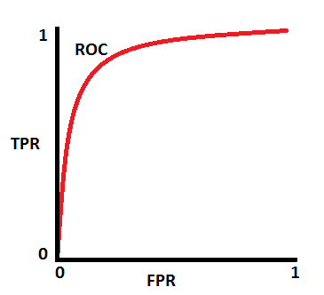
The decision threshold should maximize utility
Risk prediction scores often need to be converted into binary decisions
If risk > threshold, intervene
Typical ways to set threshold
Default to 0.5
Maximize measure of predictive ability (accuracy, F1 score, etc)
Threshold should be set in a way that maximizes utility
TP | FP
FN | TN
TP | FP
FN | TN
TP | FP
FN | TN
Points on ROC = possible decision thresholds
TP | FP
FN | TN
What threshold maximizes utility?

Slide 41
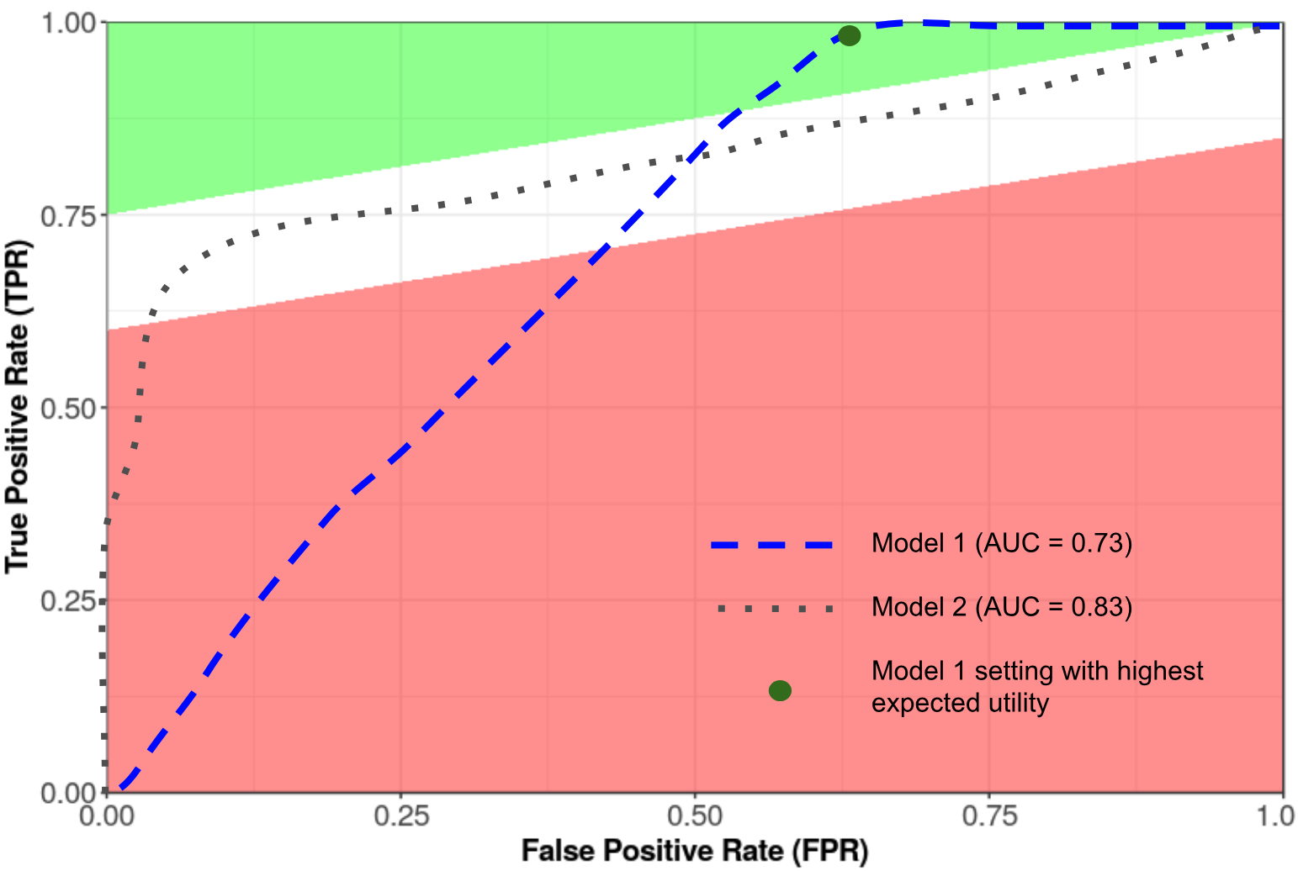
Selecting model for maximal utility
Capacity constraints put lower bound on intervention threshold
Model with higher overall AUC might perform worse in the feasible region!
David Scheinker, Nigam Shah working paper
Notes:
Utility can be calculated using the 2-by-2 table shown earlier, for anywhere in the ROC space
Utility tends to increase as you get closer to a perfect prediction model (upper right corner of ROC space),
Often, net utility of testing will be negative if the prediction model is not good enough
When comparing models, its not necessarily true that point of maximum utility is on the model with the higher overall AUC

Slide 42
Maximizing utility: CKD prediction
Capacity limit
Capacity constrained: Can only intervene in 5% riskiest patients due to limited spots in clinic
If increasing capacity is an option later, utility calculation would inform how many spots to open
Utility-maximizing threshold

Slide 43





CKD prediction implementation
Day 1
(admit)
SCr: 0.4 mg/dL
Day 2
SCr: 0.7 mg/dL
Day 3
SCr: 0.9 mg/dL
Day 4
SCr: 0.6 mg/dL
Day 5 (discharge)
SCr: 0.5 mg/dL
AKI stage = 0
AKI stage = 1
AKI stage = 2
AKI stage = 1
AKI stage = 0
Begin AKI treatment
End AKI treatment
Without model
AKI resolved by discharge, so no outpatient nephrology visits
With model
Risk score generated and sent to AKI survivor’s clinic
Highest-risk patients contacted and enrolled
Notes:
Epic cognitive layer

Slide 44
Takeaways
Algorithmic breakthroughs in individualized risk prediction have had limited impact on real-world clinical decisions
High predictive performance ≠ real-world utility
Assess potential value
Greater chance of successful implementation
Design for the workflow
Maximize utility
Notes:
Prediction isn’t fundamentally aimed at understanding the disease process but rather at informing individuals and assisting in decision-making.
The ultimate decision that is being informed should guide every step of the process from what you try to predict, what data you use to predict it, how you develop and validate your model, and how it is implemented in practice.

